Slide 1

Artificial Intelligence (M23DES221)
School of CSA /MCA- IInd sem

Slide 2
Course Objectives
The objectives of this course are to:
Develop a deeper foundational concepts and historical development of Artificial Intelligence.
Understanding problem-solving strategies, including heuristic search and adversarial techniques, to address AI challenges.
Represent knowledge effectively using propositional and first-order logic in intelligent agent decision-making.
Analyze and understand planning techniques, learning mechanisms, and applications across diverse AI domains.

Slide 3
Course Content
Unit Title: Introduction to Artificial Intelligence, Solving Problems by Searching and Adversial search
Introduction to Artificial Intelligence: Definition, foundation of AI, history of AI, Task Domains of AI, Levels of Artificial Intelligence, Applications of AI.
Intelligent agents: Agents and Environments, the concept of rationality, the nature of environments, structure of agents.
Solving Problems by Searching: Problem-solving Agents, formulating problems, Example problems, and searching for Solutions, uniformed search strategies – Breadth first search, depth first Search. Search with partial information (Heuristic search) Hill climbing, Best-First Search, A
Unit Title : Adversial search, Knowledge Represent and Symbolic Reasoning under Uncertainty
Adversial search: Games, mini-max algorithm, optimal decisions in multiplayer games, Problem in Game playing, Alpha-Beta pruning
Knowledge Represent, Knowledge Based Agent, Knowledge Representation, Knowledge Representation Techniques, Propositional Logic, First-order logic, Knowledge Engineering in FOL, Inference in First-Order Logic, Forward Chaining, and backward chaining.
Symbolic Reasoning under Uncertainty: Introduction to Nonmonotonic Reasoning; Logics for Nonmonotonic Reasoning, Default Reasoning and Minimalist Reasoning

Slide 4
Course Content
Unit Title : Planning, Learning and Robotics
Planning: The Blocks World, Components of a Planning System, Goal Stack Planning, Nonlinear Planning Using Constraint Posting, Hierarchical Planning, Other Planning Techniques.
Learning: Rote Learning, learning by Taking Advice, Learning in Problem-solving, Learning from Examples: Induction, Explanation-based Learning, Discovery, Analogy, Formal Learning Theory. Learning in Neural and Belief Networks’ How the Brain Works, Neural Networks, perceptions. Robotics: Introduction, Robot Hardware, Robotic Perception, Robotic Software Architectures, Application Domains
Unit Title : Fuzzy Logic Systems, Expert Systems, Natural Language Processing
Fuzzy Logic Systems: Introduction; Crisp Sets; Fuzzy Sets; Fuzzy Terminology; Fuzzy Logic Control-Fuzzy Room Cooler.
Expert Systems: Representing and Using Domain Knowledge, Expert System Shells, Explanation, Knowledge Acquisition.
Natural Language Processing: Definition, History of NLP, Advantages and Disadvantages of NLP, Components of NLP, real time Applications, NLP pipeline, Phases of NLP, Difficulties in NLP, NLP APIs

Slide 5
Course Outcomes
At the end of the course students will be able to:
CO1: Demonstrate a solid understanding of AI's history and foundational concepts.
CO2: Apply problem-solving skills through heuristic and adversarial search methods in AI scenarios.
CO3: Utilize effective knowledge representation techniques in decision-making for intelligent agents.
CO4: Analyze and synthesize knowledge in planning, learning, and various AI applications.

Slide 6
Reading MATERIALS
Text Books:
S. Russel and P. Nerving, Artificial intelligence – A Modern Approach, Pearson Education; 3rd Edition, 2015, ISBN: 9789332543515, ISBN: 9789332518698.
E. Rich, K. Knight, and S. B. Nair, "Artificial Intelligence," 3rd ed. Tata McGraw Hill, 2013.
Reference Books:
L. Ermine, "Expert Systems: Theory and Practice," Prentice Hall of India, 1995.
A. Basu and S. Sarkar, "Artificial Intelligence, IIT Kharagpur," https://archive.nptel.ac.in/courses/106/105/106105077/
Lavika Goel, “Artificial Intelligence: Concepts and Applications”, Wiley, 1 January 2021, ISBN: 978-8126519934.

Slide 7
Overview of the prerequisite
Basic Mathematics,
Computer science fundamentals, logic and control systems.

Slide 8
Introduction to Artificial Intelligence

Slide 9
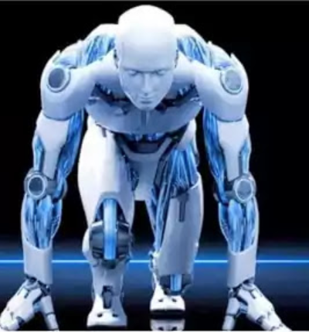

What is AI
Artificial intelligence, or AI, is technology that enables computers and machines to simulate human intelligence and problem-solving capabilities.
02

Slide 10
ARTIFICIAL INTELLIGENCE -DEFINITION
Artificial intelligence is the ability of a computer or computer-controlled robot to perform tasks that are commonly associated with the intellectual processes characteristic of humans, such as the ability to reason. Although there are as yet no AIs that match full human flexibility over wider domains or in tasks requiring much everyday knowledge, some AIs perform specific tasks as well as humans.
-B.J. Copeland
Professor of Philosophy and Director of the Turing Archive for the History of Computing, University of Canterbury, Christchurch, New Zealand
03

Slide 11
ARTIFICIAL INTELLIGENCE -DEFINITION
Artificial Intelligence(AI) is the branch of computer sciences that emphasizes the development of intelligence machines, thinking and working like humans.
-Internet Sources
https://www.iqvis.com/blog/9-powerful-examples-of-artificial-intelligence-in-use-today/
03

Slide 12
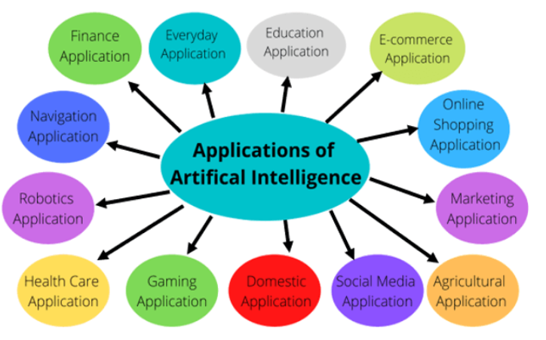

ARTIFICIAL INTELLIGENCE -Examples
04

Slide 13
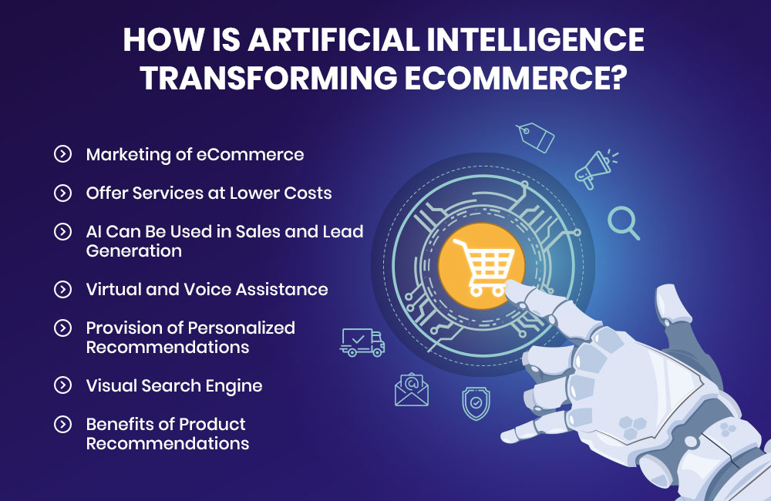
E-commerce Application
Personal Shopping
Virtual Assistants
Fraud Detection
Personalize Advertisement
Content Marketing
05

Slide 14
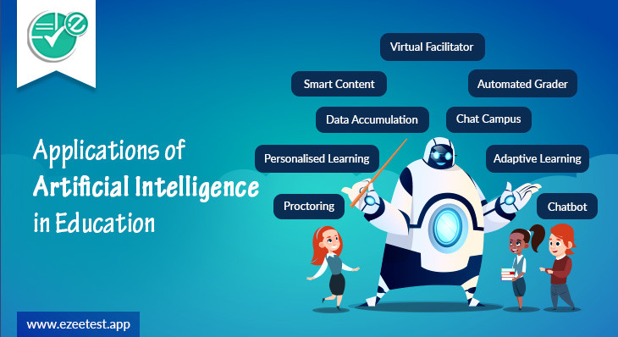
Education Application
Automation of Administrative Tasks
Smart Content Creation
intelligent voice assistants
Personalize Learning
05

Slide 15

Everyday Use Application
Automation On Vehicles
AI In Spam Filters
AI In Face Recognition
AI Recommendation System
05

Slide 16
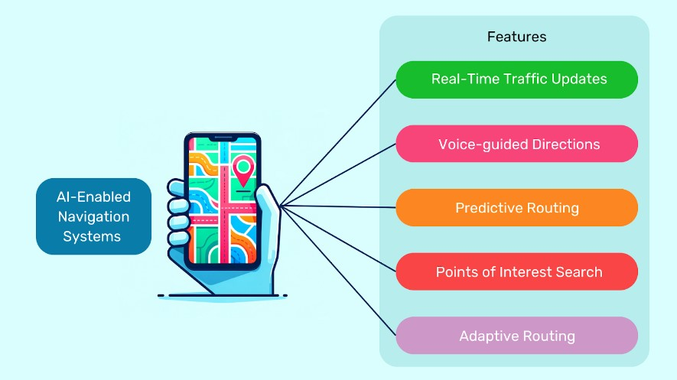
Navigation Application
Road Mapping
AI In Airline Flights
Traffic Updates
Voice Directed Routing
05

Slide 17
Robotics Applications
AI-Based Household Robots
AI-Based Manufacturing Robots
05

Slide 18
Healthcare Applications
AI-Supported Medical Image Analyses
AI Can Heal Kidney Injury
Drug Design
Predictive and Early Diagnosis
05

Slide 19
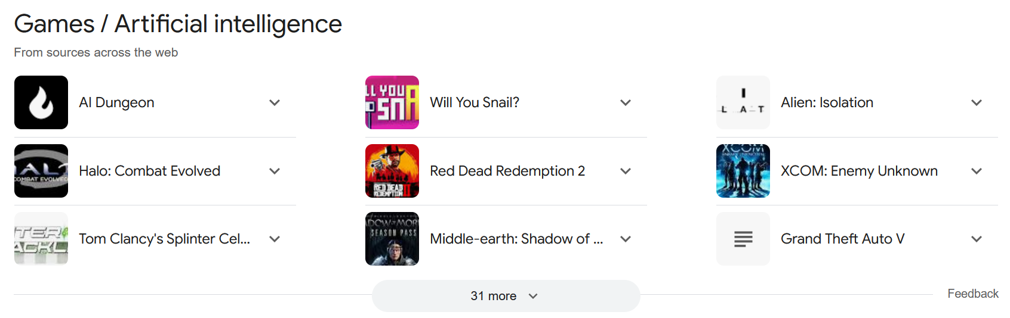
Gaming Application
05

Slide 20
Domestic Application
Alexa, Google Assistant, And Siri
Home Automation Systems
05

Slide 21
Social Media Applications
Instagram
Twitter
Facebook
06

Slide 22
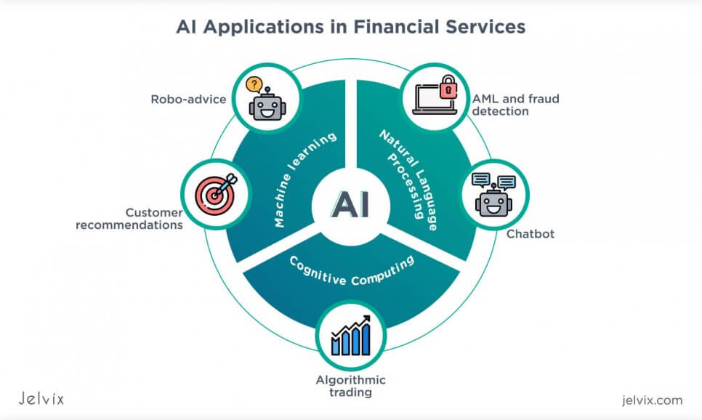
Finance Applications
Personal Finance
Consumer Finance.
Patterns and Anomalies pattern
06

Slide 23
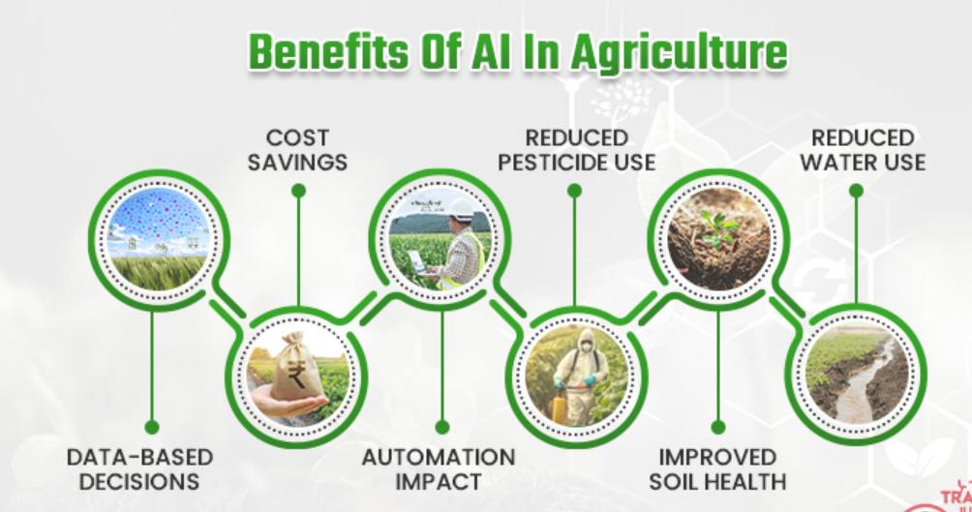
Agriculture Applications
AI In Weather Forecast
AI Eliminating Soil Deficiencies
Crop and Soil Monitoring.
Insect and Plant Disease Detection.
Livestock Health Monitoring.
Intelligent Spraying.
Automatic Weeding.
Aerial Survey and Imaging.
Produce Grading and Sorting.
07

Slide 24
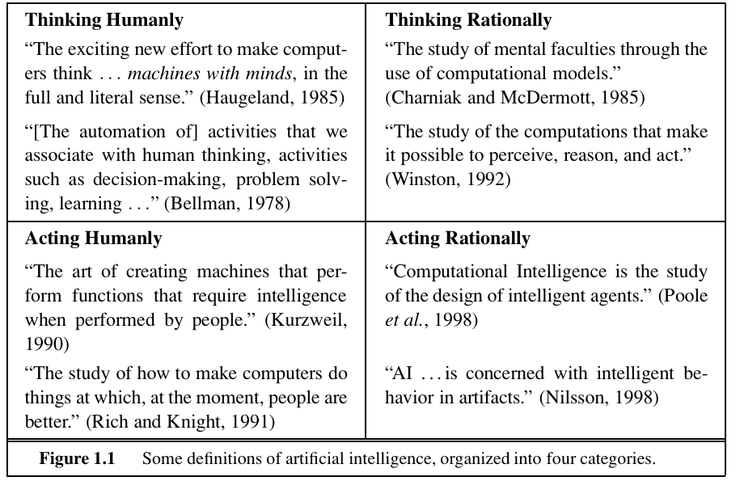
4 Views/ Approaches
The definitions on
Top: concern thought processes and reasoning
Bottom: address behavior.
Left: measure success in terms of fidelity to human performance
Right: measure against an ideal performance measure, called rationality. A system is rational if it does the “right thing,” given what it knows.

Slide 25
4 Views/ Approaches
Historically, all four approaches to AI have been followed by different people with different methods.
A human-centered approach must be, in part, an empirical science involving observations and hypotheses about human behavior.
A rationalist approach involves a combination of mathematics and engineering.
The various groups have both disparaged and helped each other.

Slide 26
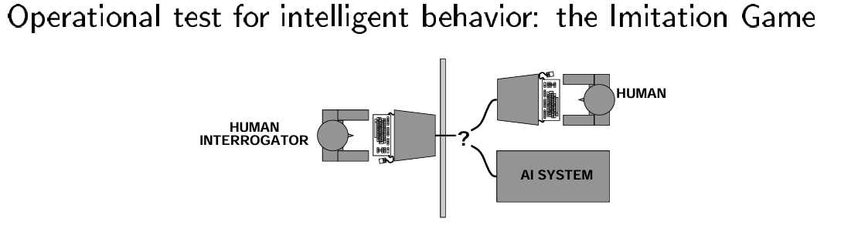
1) Acting humanly: The Turing Test approach
Alan Turing’s (1950) Turing Test was designed to provide a satisfactory operational definition of intelligence.
A computer passes the test if a human interrogator, after posing some written questions, cannot tell whether the written responses come from a person or a computer.
The computer would need to possess the following capabilities:
• natural language processing to enable it to communicate successfully in English;
• knowledge representation to store what it knows or hears;
• automated reasoning to use the stored information to answer questions and to draw new conclusions;
• machine learning to adapt to new circumstances and to detect and extrapolate patterns

Slide 27
2 Thinking humanly: The cognitive modeling approach
We must know how humans think to say that a program thinks like a human. We can learn about human thought in three ways:
• introspection—trying to catch our own thoughts as they go by
• psychological experiments—observing a person in action
• Brain imaging—observing the brain in action
Once we have a sufficiently precise theory of the mind, it becomes possible to express the theory as a computer program. If the program’s input-output behavior matches corresponding human behavior, that is evidence that some of the program’s mechanisms could also operate in humans.
The interdisciplinary field of cognitive science combines computer models from AI and experimental techniques from psychology to construct precise and testable theories of the human mind.
It examines the nature, the tasks, and the functions of cognition. Cognitive scientists study intelligence and behavior with a focus on how nervous systems represent, process, and transform information

Slide 28
3) Thinking rationally: The “laws of thought” approach
Aristotle’s Syllogisms provided patterns for argument structures that always yielded correct conclusions when given correct premises. Example,
Jim is a man. All men are mortal; Therefore, Jim is mortal.
This initiated the field of logic.
The logicist tradition within AI hopes to build programs that can solve any solvable problems described in logical notation, thereby creating intelligent systems.
The theory of probability allows rigorous reasoning with uncertain information.
The probability principle allows the construction of a comprehensive model of rational thought, leading from raw perceptual information to an understanding of how the world works to predictions about the future

Slide 29
4) Acting rationally: The rational agent approach
An agent is just something that acts.
A rational agent acts to achieve the best possible outcome or, when uncertain, the best-expected outcome.
The rational agent approach is more amenable to scientific development than those based on human behavior or thought.
AI has focused on studying and constructing agents that do the right thing. What counts as the right thing is doing the right thing according to the objective we provide to the agent.
This general paradigm is so pervasive that we might call it the standard model.

Slide 30
Foundation of ai
Many fields contributed to the eventual formation of AI;
It is very important to know these fields and their contributions to AI to have an intuitive understanding of AI.
A brief history of the disciplines that contributed ideas, viewpoints, and techniques to AI

Slide 31

Foundation of ai
Philosophy
Can formal rules be used to draw valid conclusions?
How does the mind arise from a physical brain?
Where does knowledge come from?
How does knowledge lead to action?
These necessary questions posed in the field of philosophy are at the heart of AI.
2. Mathematics
What are the formal rules to draw valid conclusions?
What can be computed?
How do we reason with uncertain information?
The three fundamental areas-
logic, computation, and probability laid the foundation of AI.

Slide 32
Foundation of ai
3. Economics
How should we make decisions following our preferences?
How should we do this when others may not go along?
How should we do this when the payoff may be far?
Decision theory, which combines probability theory with utility theory to provide a formal and complete framework for decisions made under uncertainty, also contributed to AI from economics.
4. Neuroscience
How do brains process information?
Neuroscience is the study of the nervous system, particularly the brain.
The brain’s workings and the neurons associated with it helped develop various mechanisms, such as artificial neural networks, in AI.

Slide 33
Foundation of ai
5. Psychology
How do humans and animals think and act?
Behaviorism and cognitive psychology contributed to the understanding of the mind and its thinking process, which can be applied later in AI.
6. Computer engineering
• How can we build an efficient computer?
AI is very much a subject that comes under computer engineering.
Designing the architecture, software and hardware that could make intelligent computer systems can only be done through the progress in computer engineering.

Slide 34
Foundation of ai
7. Control Theory and Cybernetics
How can artifacts operate under their control?
Control theory is an interdisciplinary field that deals with the behavior of the dynamical system.
◼ Water-flow regulator, steam engine governor, thermostat
❑ The theory of stable feedback systems (1894)
◼ Build systems that transition from the initial state to the goal state with minimum energy
◼ In 1950, control theory could only describe linear systems, and AI largely rose as a response to this shortcoming
Cybernetics encompasses studying how systems regulate themselves and take action toward goals based on environmental feedback.

Slide 35
Foundation of ai
8. Linguistics
How does language relate to thought?
Linguistics is the scientific study of language.
It encompasses analyzing every aspect of language and the methods for studying and modeling them.
Natural Language Processing of AI is heavily influenced by linguistics.
❑ Analysis of human language reveals thought taking place in ways not understood in other settings
◼ Children can create sentences they have never heard before
◼ Language and thought are believed to be tightly intertwined

Slide 36
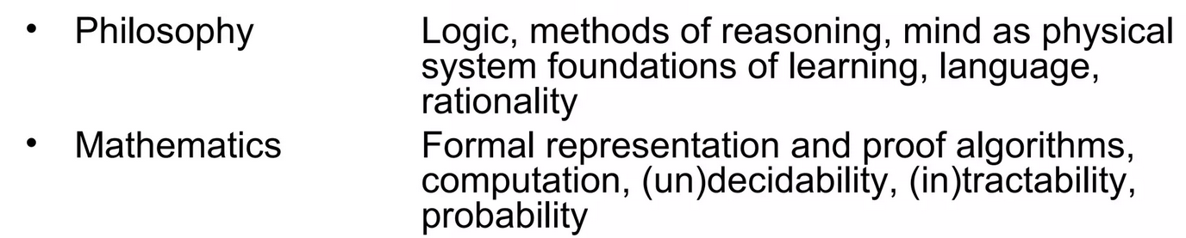
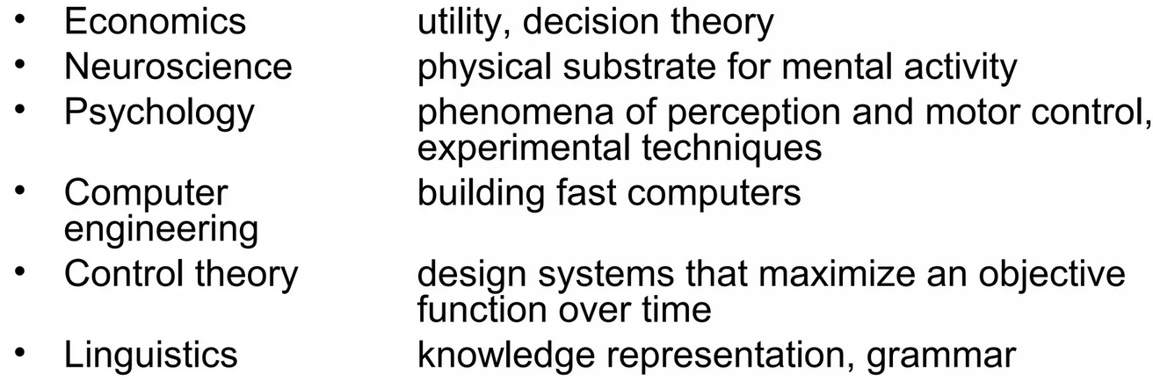
Foundation of ai

Slide 37
History of AI

Slide 38
The gestation of artificial intelligence (1943–1955)
1943- Warren McCulloch and Walter Pitts : Boolean Circuit Model of the Brain
1950: Alan Turing published “Computer Machinery and Intelligence” which proposed a test of machine intelligence called The Imitation Game.
1952: A computer scientist named Arthur Samuel developed a program to play checkers, which is the first to ever learn the game independently.
1955: John McCarthy held a workshop at Dartmouth on “artificial intelligence” which is the first use of the word, and how it came into popular usage.

Slide 39
AI maturation: 1957-1979
1958: John McCarthy created LISP (acronym for List Processing), the first programming language for AI research, which is still in popular use to this day.
1959: Arthur Samuel created the term “machine learning” when doing a speech about teaching machines to play chess better than the humans who programmed them.
1961: The first industrial robot Unimate started working on an assembly line at General Motors in New Jersey, tasked with transporting die casings and welding parts on cars (which was deemed too dangerous for humans).
1965: Edward Feigenbaum and Joshua Lederberg created the first “expert system” which was a form of AI programmed to replicate the thinking and decision-making abilities of human experts.
1966: Joseph Weizenbaum created the first “chatterbot” (later shortened to chatbot), ELIZA, a mock psychotherapist, that used natural language processing (NLP) to converse with humans.1968: Soviet mathematician Alexey Ivakhnenko published “Group Method of Data Handling” in the journal “Avtomatika,” which proposed a new approach to AI that would later become what we now know as “Deep Learning.”

Slide 40
AI maturation: 1957-1979
1973: An applied mathematician named James Lighthill gave a report to the British Science Council, underlining that strides were not as impressive as those that had been promised by scientists, which led to much-reduced support and funding for AI research from the British government.
1979: James L. Adams created The Standford Cart in 1961, which became one of the first examples of an autonomous vehicle. In ‘79, it successfully navigated a room full of chairs without human interference.
1979: The American Association of Artificial Intelligence which is now known as the Association for the Advancement of Artificial Intelligence (AAAI) was founded.

Slide 41
AI boom: 1980-1987
1980: First conference of the AAAI was held at Stanford.
1980: The first expert system came into the commercial market, known as XCON (expert configurer). It was designed to assist in the ordering of computer systems by automatically picking components based on the customer’s needs.
1981: The Japanese government allocated $850 million (over $2 billion dollars in today’s money) to the Fifth Generation Computer project. Their aim was to create computers that could translate, converse in human language, and express reasoning on a human level.
1984: The AAAI warns of an incoming “AI Winter” where funding and interest would decrease, and make research significantly more difficult.
1985: An autonomous drawing program known as AARON is demonstrated at the AAAI conference.
1986: Ernst Dickmann and his team at Bundeswehr University of Munich created and demonstrated the first driverless car (or robot car). It could drive up to 55 mph on roads that didn’t have other obstacles or human drivers.
1987: Commercial launch of Alacrity by Alactrious Inc. Alacrity was the first strategy managerial advisory system, and used a complex expert system with 3,000+ rules.

Slide 42
AI winter: 1987-1993
1987: The market for specialized LISP-based hardware collapsed due to cheaper and more accessible competitors that could run LISP software, including those offered by IBM and Apple. This caused many specialized LISP companies to fail as the technology was now easily accessible.
1988: A computer programmer named Rollo Carpenter invented the chatbot Jabberwacky, which he programmed to provide interesting and entertaining conversation to humans.

Slide 43
Task domains
Robotic vehicles
Speech recognition
Autonomous planning and scheduling
Game playing
Spam fighting
Logistics planning
Robotics
Machine Translation

Slide 44
AI Levels
ANI: Artificial Narrow Intelligence
AGI: Artificial General Intelligence
ASI: Artificial Super Intelligence

Slide 45
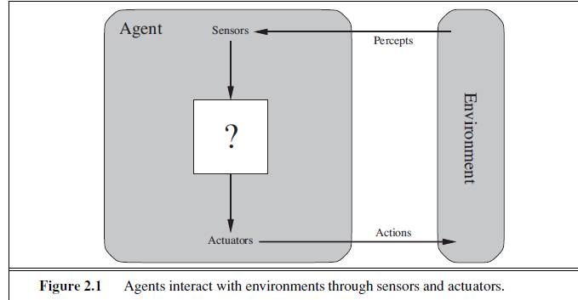
Intelligent agents
An agent is anything that can be viewed as perceiving its environment through sensors and acting upon that environment through actuators
A human agent has eyes, ears, and other organs for sensors and hands, legs, vocal tract, and so on for actuators

Slide 46
AGENTS AND ENVIRONMENTS
An agent’s percept sequence is the complete history of everything the agent has ever perceived.
In general, an agent’s choice of action at any given instant can depend on the entire percept sequence observed to date, but not on anything it hasn’t perceived
Mathematically, we say that an agent’s behavior is described by the agent function that maps any given percept sequence to an action.

Slide 47
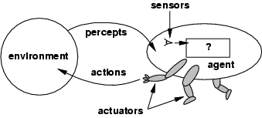
Agent
The agent function maps from percept sequence to actions: [f: P* → A]
The agent program runs on the physical architecture to produce f
agent = architecture + program

Slide 48
A Simple intelligent agent architecture

Slide 49
Software Agents
Software agents (or software robots or softbots) exist in rich, unlimited domains.
Imagine a softbot designed to fly a flight simulator for a 747. The simulator is a very detailed, complex environment, and the software agent must choose from a wide variety of actions in real time.
Or
Imagine a softbot designed to scan online news sources and show the interesting items to its customers.
The appropriate design of the agent program depends on the percepts, actions, goals, and environment.

Slide 51
Example of Intelligent Agent

Slide 52
AGENTS AND ENVIRONMENTS
We can tabulate the agent function that describes any given agent;
construct this table by trying out all possible percept sequences and recording which actions the agent does in response.
This is called external characterization of the agent
Internal characterization, the agent function for an artificial agent will be implemented by an agent program

Slide 53
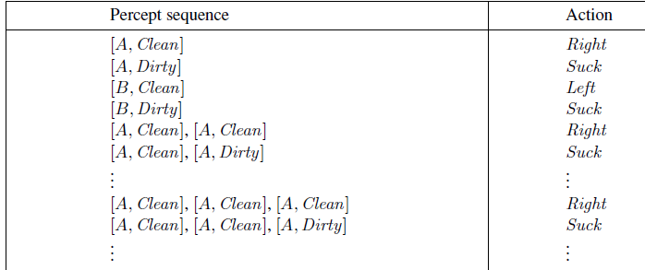
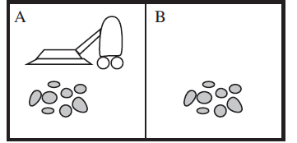
AGENTS AND ENVIRONMENTS
Partial tabulation of a simple agent function for the vacuum-cleaner world

Slide 54
Concept of Rationality
Rational agent
One that does the right thing
= every entry in the table for the agent function is correct (rational).
What is correct?
The actions that cause the agent to be most successful
So we need ways to measure success.

Slide 55
Rational agent
A Rational Agent is one that does an action that will cause it to be most successful
Human agent: eyes, ears and other organs for sensors; hands, legs, mouth and other body parts for effectors
Robotic agent: cameras and infrared range finders for sensors; various motors for effectors
A software agent has encoded bit strings as its percepts and actions

Slide 56
Performance measure
Performance measure
An objective function that determines
How the agent does successfully
E.g., 90% or 30% ?
An agent, based on its percepts
→ action sequence :
if desirable, it is said to be performing well.
No universal performance measure for all agents

Slide 57
Performance measure
A general rule:
Design performance measures according to
What one actually wants in the environment
Rather than how one thinks the agent should behave
E.g., in vacuum-cleaner world
We want the floor clean, no matter how the agent behave
We don’t restrict how the agent behaves

Slide 58
Rationality
What is rational at any given time depends on four things:
The performance measure defining the criterion of success
The agent’s prior knowledge of the environment
The actions that the agent can perform
The agents’s percept sequence up to now

Slide 59
Rational agent
For each possible percept sequence,
an rational agent should select
an action expected to maximize its performance measure, given the evidence provided by the percept sequence and whatever built-in knowledge the agent has
E.g., an exam
Maximize marks, based on
the questions on the paper & your knowledge

Slide 60
Example of a Rational agent
Performance measure
Awards one point for each clean square
at each time step, over 10000 time steps
Prior knowledge about the environment
The geography of the environment
Only two squares
The effect of the actions

Slide 61
Example of a rational agent
Actions that can perform
Left, Right, Suck and NoOp
Percept sequences
Where is the agent?
Whether the location contains dirt?
Under this circumstance, the agent is rational.

Slide 62
Task environments
Task environments are the problems
While the rational agents are the solutions
Specifying the task environment
PEAS description as fully as possible
Performance
Environment
Actuators
Sensors
In designing an agent, the first step must always be to specify the task environment as fully as possible.
Use automated taxi driver as an example

Slide 63
Task environments
Performance measure
How can we judge the automated driver?
Which factors are considered?
getting to the correct destination
minimizing fuel consumption
minimizing the trip time and/or cost
minimizing the violations of traffic laws
maximizing the safety and comfort, etc.

Slide 64
Task environments
Environment
A taxi must deal with a variety of roads
Traffic lights, other vehicles, pedestrians, stray animals, road works, police cars, etc.
Interact with the customer

Slide 65
Task environments
Actuators (for outputs)
Control over the accelerator, steering, gear shifting and braking
A display to communicate with the customers
Sensors (for inputs)
Detect other vehicles, road situations
GPS (Global Positioning System) to know where the taxi is
Many more devices are necessary

Slide 66
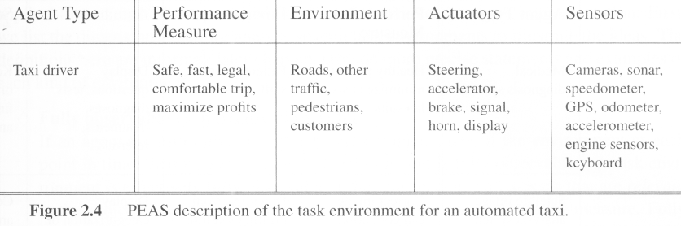
Task environments
A sketch of automated taxi driver

Slide 67
Properties of task environments
Fully observable vs. Partially observable
If an agent’s sensors give it access to the complete state of the environment at each point in time then the environment is effectively and fully observable
if the sensors detect all aspects
That are relevant to the choice of action

Slide 68
Partially observable
An environment might be Partially observable because of noisy and inaccurate sensors or because parts of the state are simply missing from the sensor data.
Example:
A local dirt sensor of the cleaner cannot tell
Whether other squares are clean or not

Slide 69
Properties of task environments
Deterministic vs. stochastic
next state of the environment Completely determined by the current state and the actions executed by the agent, then the environment is deterministic, otherwise, it is Stochastic.
Strategic environment: deterministic except for actions of other agents
-Cleaner and taxi driver are:
Stochastic because of some unobservable aspects → noise or unknown

Slide 70
Properties of task environments
Episodic vs. sequential
An episode = agent’s single pair of perception & action
The quality of the agent’s action does not depend on other episodes
Every episode is independent of each other
Episodic environment is simpler
The agent does not need to think ahead
Sequential
Current action may affect all future decisions
-Ex. Taxi driving and chess.

Slide 71
Properties of task environments
Static vs. dynamic
A dynamic environment is always changing over time
E.g., the number of people in the street
While static environment
E.g., the destination
Semidynamic
environment is not changed over time
but the agent’s performance score does

Slide 72
Properties of task environments
Discrete vs. continuous
If there are a limited number of distinct states, clearly defined percepts and actions, the environment is discrete
E.g., Chess game
Continuous: Taxi driving

Slide 73
Properties of task environments
Single agent VS. multiagent
Playing a crossword puzzle – single agent
Chess playing – two agents
Competitive multiagent environment
Chess playing
Cooperative multiagent environment
Automated taxi driver
Avoiding collision

Slide 74
Properties of task environments
Known vs. unknown
This distinction refers not to the environment itself but to the agent’s (or designer’s) state of knowledge about the environment.
-In known environment, the outcomes for all actions are
given. ( example: solitaire card games).
- If the environment is unknown, the agent will have to learn how it works in order to make good decisions.( example: new video game).

Slide 75
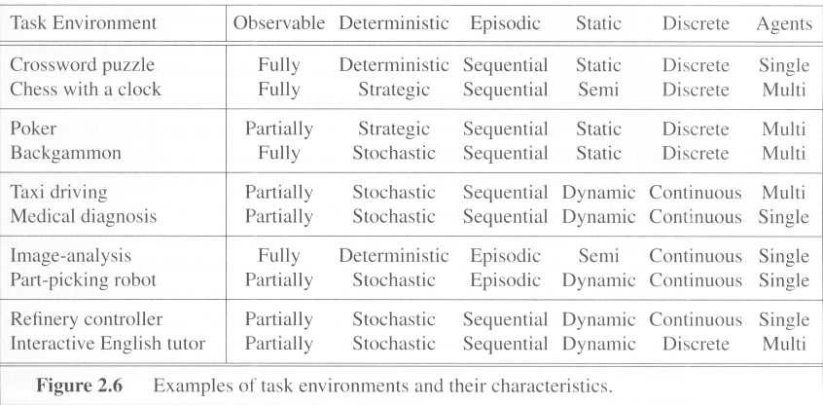
Examples of task environments

Slide 76
Structure of agents

Slide 77
Structure of agents
Agent = architecture + program
Architecture = some sort of computing device (sensors + actuators)
(Agent) Program = some function that implements the agent mapping = “?”
Agent Program = Job of AI

Slide 78
Agent Programs
Input for Agent Program
Only the current percept
Input for Agent Function
The entire percept sequence
The agent must remember all of them
Implement the agent program as
A look up table (agent function)

Slide 79
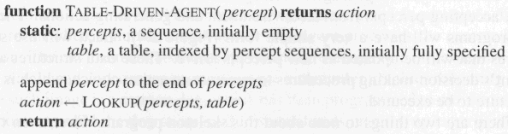
Agent Programs
Skeleton design of an agent program

Slide 80
Agent Programs
P = the set of possible percepts
T= lifetime of the agent
The total number of percepts it receives
Size of the look up table
Consider playing chess
P =10, T=150
Will require a table of at least 10¹⁵⁰ entries

Slide 81
Agent Programs
Despite of huge size, look up table does what we want.
The key challenge of AI
Find out how to write programs that, to the extent possible, produce rational behavior
From a small amount of code
Rather than a large amount of table entries
E.g., a five-line program of Newton’s Method
V.s. huge tables of square roots, sine, cosine, …

Slide 82
Types of agent programs
Four types
Simple reflex agents
Model-based reflex agents
Goal-based agents
Utility-based agents

Slide 83
Simple reflex agents
It uses just condition-action rules
The rules are like the form “if … then …”
efficient but have narrow range of applicability
Because knowledge sometimes cannot be stated explicitly
Work only
if the environment is fully observable

Slide 84
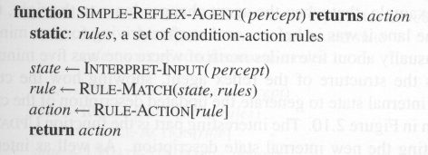
Simple reflex agents

Slide 85
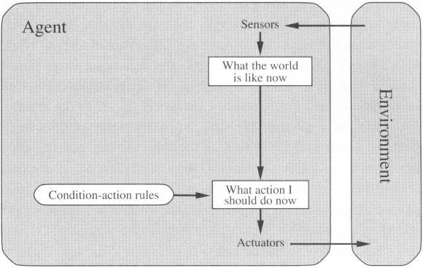
Simple reflex agents (2)

Slide 86
Model-based Reflex Agents
For the world that is partially observable
the agent has to keep track of an internal state
That depends on the percept history
Reflecting some of the unobserved aspects
E.g., driving a car and changing lane
Requiring two types of knowledge
How the world evolves independently of the agent
How the agent’s actions affect the world

Slide 87
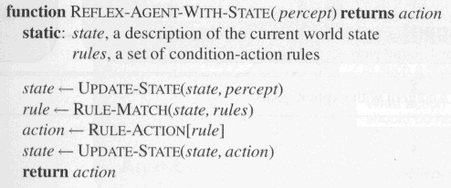
Model-based Reflex Agents
The agent is with memory

Slide 88
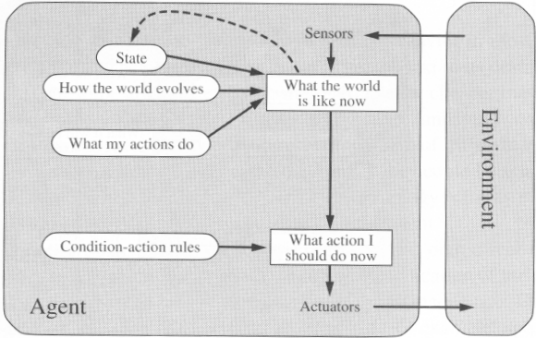
Model-based Reflex Agents

Slide 89
Goal-based agents
Current state of the environment is always not enough
The goal is another issue to achieve
Judgment of rationality / correctness
Actions chosen → goals, based on
the current state
the current percept

Slide 90
Goal-based agents
Conclusion
Goal-based agents are less efficient
but more flexible
Agent ← Different goals ← different tasks
Search and planning
two other sub-fields in AI
to find out the action sequences to achieve its goal

Slide 91
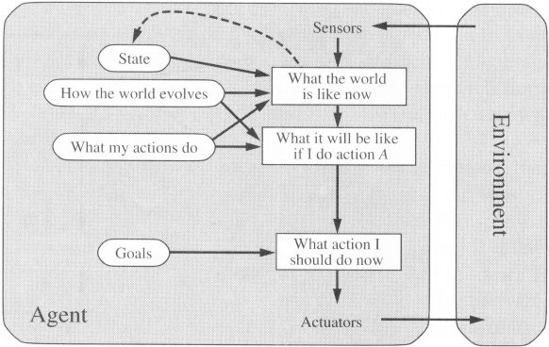
Goal-based agents

Slide 92
Goal Based Agents
Assumes the problem environment is:
Static
The plan remains the same
Observable
Agent knows the initial state
Discrete
Agent can enumerate the choices
Deterministic
Agent can plan a sequence of actions such that each will lead to an intermediate state
The agent carries out its plans with its eyes closed
Certain of what’s going on
Open loop system

Slide 93
Utility-based agents
Goals alone are not enough
to generate high-quality behavior
E.g. meals in Canteen, good or not ?
Many action sequences → the goals
some are better and some worse
If goal means success,
then utility means the degree of success (how successful it is)

Slide 94
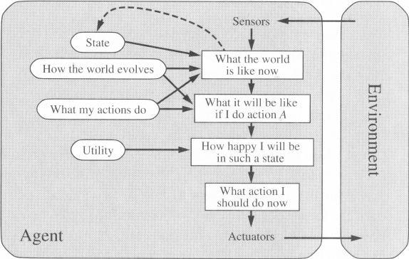
Utility-based agents (2)

Slide 95
Utility-based agents
it is said state A has higher utility
If state A is more preferred than others
Utility is therefore a function
that maps a state onto a real number
the degree of success

Slide 96
Utility-based agents (2)
Utility has several advantages:
When there are conflicting goals,
Only some of the goals but not all can be achieved
utility describes the appropriate trade-off
When there are several goals
None of them are achieved certainly
utility provides a way for the decision-making

Slide 97
Learning Agents
After an agent is programmed, can it work immediately?
No, it still need teaching
In AI,
Once an agent is done
We teach it by giving it a set of examples
Test it by using another set of examples
We then say the agent learns
A learning agent

Slide 98
Learning Agents
Four conceptual components
Learning element
Making improvement
Performance element
Selecting external actions
Critic
Tells the Learning element how well the agent is doing with respect to fixed performance standard.
(Feedback from user or examples, good or not?)
Problem generator
Suggest actions that will lead to new and informative experiences.

Slide 99
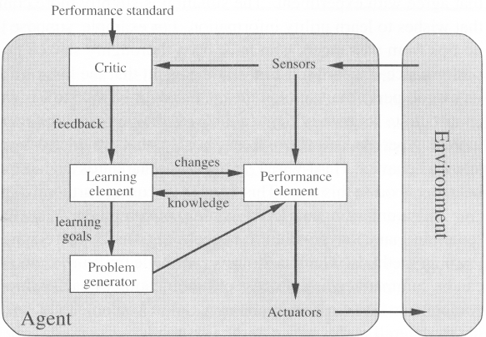
Learning Agents

Slide 100
Problem Solving Agents
Problem solving agent
A kind of “goal based” agent
Finds sequences of actions that lead to desirable states.
The algorithms are uninformed
No extra information about the problem other than the definition
No extra information
No heuristics (rules)

Slide 101
Well Defined Problems and Solutions
A problem
Initial state
Actions and Successor Function
Goal test
Path cost

Slide 102
Example: Water Pouring
Given a 4 gallon bucket and a 3 gallon bucket, how can we measure exactly 2 gallons into one bucket?
There are no markings on the bucket
You must fill each bucket completely

Slide 103
Example: Water Pouring
Initial state:
The buckets are empty
Represented by the tuple ( 0 0 )
Goal state:
One of the buckets has two gallons of water in it
Represented by either ( x 2 ) or ( 2 x )
Path cost:
1 per unit step

Slide 104
Example: Water Pouring
Actions and Successor Function
Fill a bucket
(x y) -> (3 y)
(x y) -> (x 4)
Empty a bucket
(x y) -> (0 y)
(x y) -> (x 0)
Pour contents of one bucket into another
(x y) -> (0 x+y) or (x+y-4, 4)
(x y) -> (x+y 0) or (3, x+y-3)

Slide 105
Example: Water Pouring

Slide 106
Example: Eight Puzzle
States:
Description of the eight tiles and location of the blank tile
Successor Function:
Generates the legal states from trying the four actions {Left, Right, Up, Down}
Goal Test:
Checks whether the state matches the goal configuration
Path Cost:
Each step costs 1
7 | 2 | 4
5 |  | 6
8 | 3 | 1
1 | 2 | 3
4 | 5 | 6
7 | 8

Slide 107
Example: Eight Puzzle
Eight puzzle is from a family of “sliding –block puzzles”
NP Complete
8 puzzle has 9!/2 = 181440 states
15 puzzle has approx. 1.3*10¹² states
24 puzzle has approx. 1*10²⁵ states

Slide 108
Example: Eight Queens
Place eight queens on a chess board such that no queen can attack another queen
No path cost because only the final state counts!
Incremental formulations
Complete state formulations
Q
Q
Q
Q
Q
Q
Q
Q

Slide 109
Example: Eight Queens
States:
Any arrangement of 0 to 8 queens on the board
Initial state:
No queens on the board
Successor function:
Add a queen to an empty square
Goal Test:
8 queens on the board and none are attacked
64*63*…*57 = 1.8*10¹⁴ possible sequences
Ouch!
Q
Q
Q
Q
Q
Q
Q
Q

Slide 110
Example: Eight Queens
States:
Arrangements of n queens, one per column in the leftmost n columns, with no queen attacking another are states
Successor function:
Add a queen to any square in the leftmost empty column such that it is not attacked by any other queen.
2057 sequences to investigate
Q
Q
Q
Q
Q
Q
Q
Q

Slide 111
Other Toy Examples
Another Example: Jug Fill
Another Example: Black White Marbles
Another Example: Row Boat Problem
Another Example: Sliding Blocks
Another Example: Triangle Tee

Slide 112
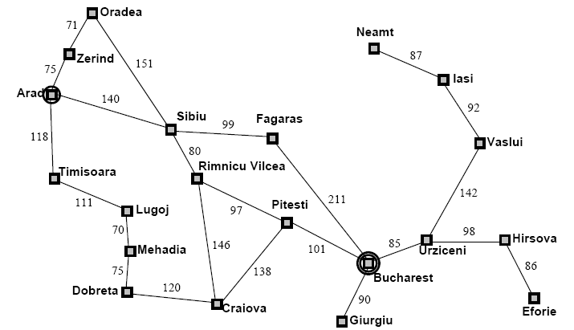
Example: Map Planning

Slide 113
Searching For Solutions
Initial State
e.g. “At Arad”
Successor Function
A set of action state pairs
S(Arad) = {(Arad->Zerind, Zerind), …}
Goal Test
e.g. x = “at Bucharest”
Path Cost
sum of the distances traveled

Slide 114
Searching For Solutions
Having formulated some problems…how do we solve them?
Search through a state space
Use a search tree that is generated with an initial state and successor functions that define the state space

Slide 115
Searching For Solutions
A state is (a representation of) a physical configuration
A node is a data structure constituting part of a search tree
Includes parent, children, depth, path cost
States do not have children, depth, or path cost
The EXPAND function creates new nodes, filling in the various fields and using the SUCCESSOR function of the problem to create the corresponding states

Slide 116
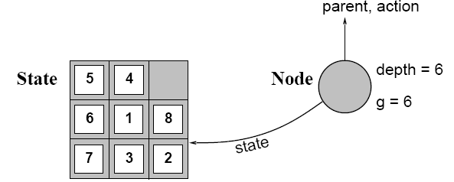
Searching For Solutions

Slide 117
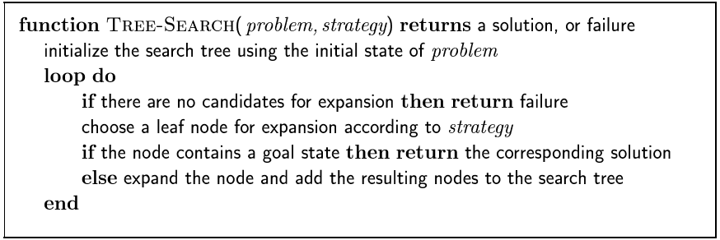
Searching For Solutions

Slide 118
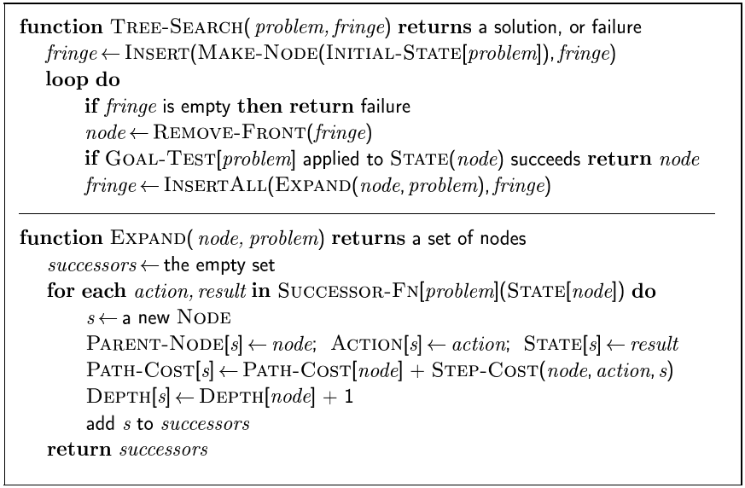
Searching For Solutions

Slide 119
Uninformed Search Strategies
Uninformed strategies use only the information available in the problem definition
Also known as blind searching
Breadth-first search
Uniform-cost search
Depth-first search
Depth-limited search
Iterative deepening search

Slide 120
Comparing Uninformed Search Strategies
Completeness
Will a solution always be found if one exists?
Time
How long does it take to find the solution?
Often represented as the number of nodes searched
Space
How much memory is needed to perform the search?
Often represented as the maximum number of nodes stored at once
Optimal
Will the optimal (least cost) solution be found?
Page 81 in AIMA text

Slide 121
Comparing Uninformed Search Strategies
Time and space complexity are measured in
b – maximum branching factor of the search tree
m – maximum depth of the state space
d – depth of the least cost solution

Slide 122
Breadth-First Search
Recall from Data Structures the basic algorithm for a breadth-first search on a graph or tree
Expand the shallowest unexpanded node
Place all new successors at the end of a FIFO queue

Slide 123
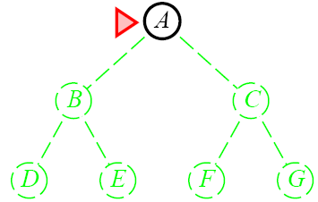
Breadth-First Search

Slide 124
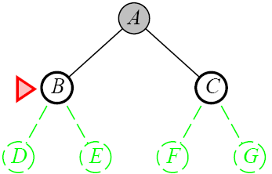
Breadth-First Search

Slide 125
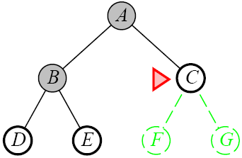
Breadth-First Search

Slide 126
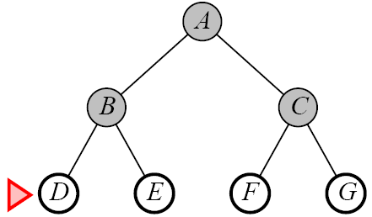
Breadth-First Search

Slide 127
Depth-First Search
Recall from Data Structures the basic algorithm for a depth-first search on a graph or tree
Expand the deepest unexpanded node
Unexplored successors are placed on a stack until fully explored

Slide 128
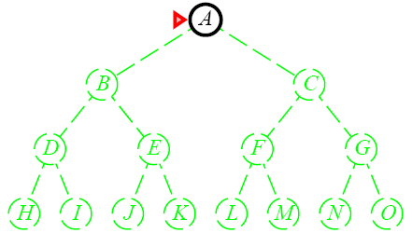
Depth-First Search

Slide 129
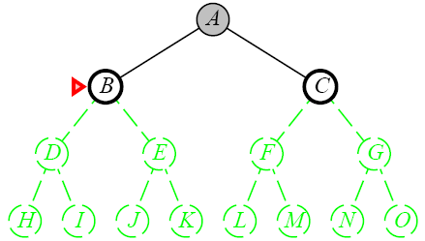
Depth-First Search

Slide 130
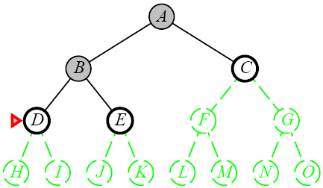
Depth-First Search

Slide 131
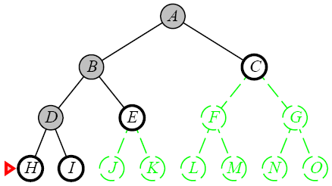
Depth-First Search

Slide 132
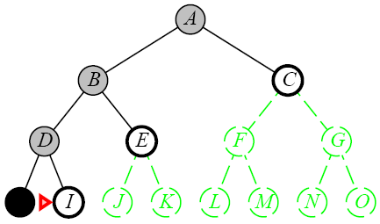
Depth-First Search

Slide 133
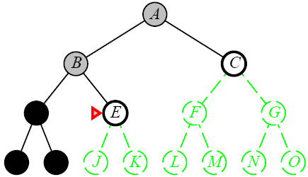
Depth-First Search

Slide 134
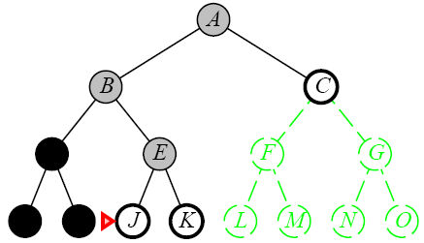
Depth-First Search

Slide 135
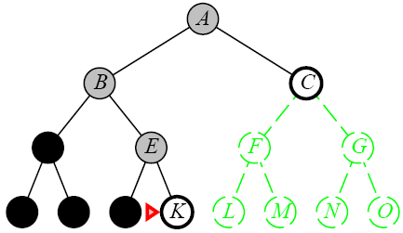
Depth-First Search

Slide 136
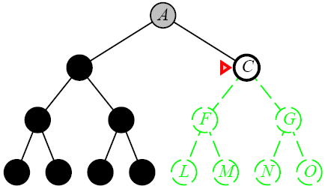
Depth-First Search

Slide 137
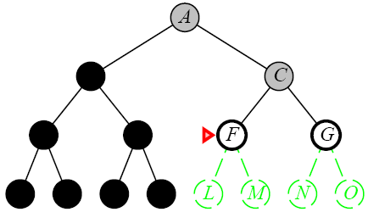
Depth-First Search

Slide 138
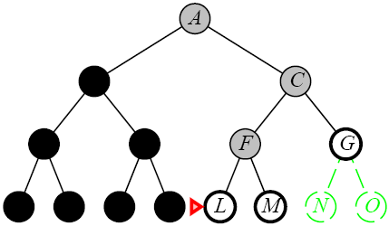
Depth-First Search

Slide 139
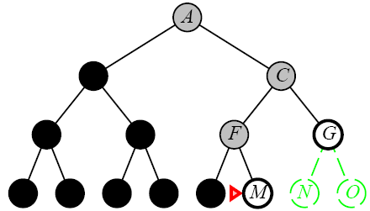
Depth-First Search

Slide 140
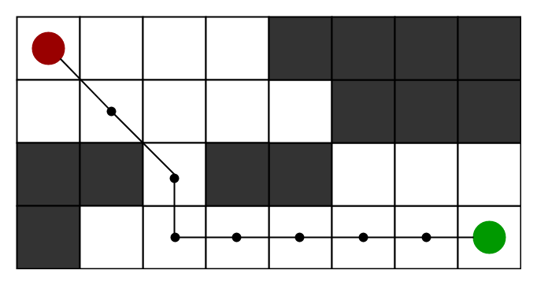
A* Algorithm
A* Search algorithm is one of the best and popular technique used in path-finding and graph traversals.
A* is a powerful graph traversal and path finding algorithm widely used in artificial intelligence and computer science

Slide 141
A* Algorithm
It is mainly used to find the shortest path between two nodes in a graph, given the estimated cost of getting from the current node to the destination node.
The main advantage of the algorithm is its ability to provide an optimal path by exploring the graph in a more informed way compared to traditional search algorithms such as Dijkstra's algorithm.

Slide 142
A* Algorithm
The main idea of A* is to evaluate each node based on two parameters:
g(n): the actual cost to get from the initial node to node n. It represents the sum of the costs of node n outgoing edges.
h(n): Heuristic cost (also known as "estimation cost") from node n to destination node n.
This problem-specific heuristic function must be acceptable, meaning it never overestimates the actual cost of achieving the goal. The evaluation function of node n is defined as f(n) = g(n) h(n).

Slide 143
A* Algorithm
To find the lowest cost path, a search tree is constructed in the following way:
Initialize a tree with the root node being the start node S.
Remove the top node from the open list for exploration.
Add the current node to the closed list.
Add all nodes that have an incoming edge from the current node as child nodes in the tree.
Update the lowest cost to reach the child node.
Compute the evaluation function for every child node and add them to the open list.

Slide 144
Example

Slide 145
A*
Step-01:
We start with node A: Node B and Node F can be reached from node A.
A* Algorithm calculates f(B) and f(F).
f(B) = 6 + 8 = 14
f(F) = 3 + 6 = 9
Since f(F) < f(B), so it decides to go to node F.
Path- A → F
Step-02:
Node G and Node H can be reached from node F.
A* Algorithm calculates f(G) and f(H).
f(G) = (3+1) + 5 = 9
f(H) = (3+7) + 3 = 13
Since f(G) < f(H), so it decides to go to node G.
Path- A → F → G

Slide 146
A*
Step-03:
Node I can be reached from node G.
A* Algorithm calculates f(I).
f(I) = (3+1+3) + 1 = 8
It decides to go to node I.
Path- A → F → G → I
Step-04:
Node E, Node H and Node J can be reached from node I.
A* Algorithm calculates f(E), f(H) and f(J).
f(E) = (3+1+3+5) + 3 = 15
f(H) = (3+1+3+2) + 3 = 12
f(J) = (3+1+3+3) + 0 = 10
Since f(J) is least, so it decides to go to node J.
Path- A → F → G → I → J
This is the required shortest path from node A to node J.

Slide 148
Hill Climbing Algorithm
Hill climbing algorithm is a local search algorithm which continuously moves in the direction of increasing elevation/value to find the peak of the mountain or best solution to the problem. It terminates when it reaches a peak value where no neighbor has a higher value.
Hill climbing algorithm is a technique which is used for optimizing the mathematical problems. One of the widely discussed examples of Hill climbing algorithm is Traveling-salesman Problem in which we need to minimize the distance traveled by the salesman.
It is also called greedy local search as it only looks to its good immediate neighbor state and not beyond that.

Slide 149
Hill Climbing Algorithm
A node of hill climbing algorithm has two components which are state and value.
Hill Climbing is mostly used when a good heuristic is available.
In this algorithm, we don't need to maintain and handle the search tree or graph as it only keeps a single current state.

Slide 150
Hill Climbing Algorithm- Advantages
Ideal for complex optimization problem. A hill climbing algorithm is first invention of hill climbers.
It uses much less RAM for the current problem state and the solutions located around it than comparing the algorithm to a tree search method which will require inspecting the entire tree.
Consequently, reducing the total memory resources to be used. Space is what matters solutions should occupy a convenient area to consume as little of memory as possible.
When it comes to the acceleration of the hill up, most of the time it brings a closure in the local maximum straight away. This is the route if having quickly getting a solution, outshining acquiring a global maximum, is an incentive.

Slide 151
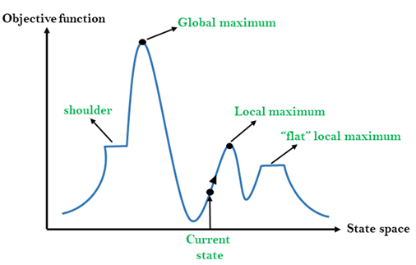
state-space landscape

Slide 152

Thank You

